Slide 1
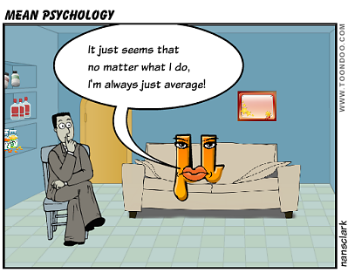
Chapter 3: Numerical Summary Measures
http://anengineersaspect.blogspot.com/2013_05_01_archive.html

Slide 2
Numerical Summary Measures: Goals
Describe the center of a distribution by:
  mean
  Median
  mode
Compare the mean and median
Describe the measure of spread:
  range
  Variance and standard deviation
  Quartiles
Be able to determine which summary statistics are appropriate for a given situation
Empirical Rule and introduction to the normal distribution
Describe a distribution by a boxplot (five-number summary and outliers)

Slide 3
Definition
Measures of central tendency indicate where the majority of the data is centered, bunched or clustered.

Slide 4
Notation
lower case letters, x, y, z indicate the variables.
x₁, x₂, x₃,….., x_{n} refers to a set of fixed observations of a variable.
n : This is the number of observations in a data set which is called the sample size.

Slide 5
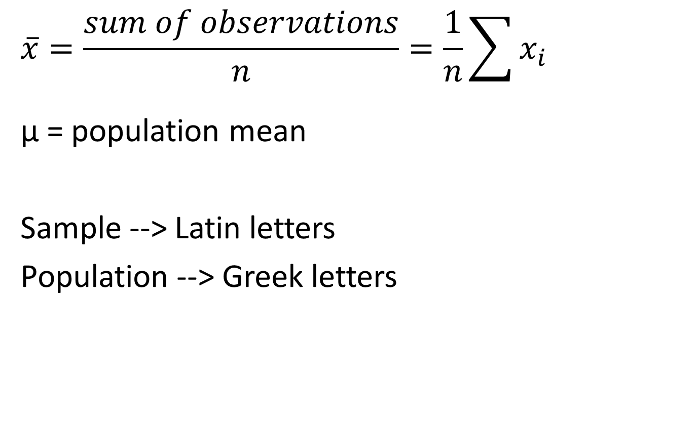
Sample Mean
$$\overline{x}=\frac{sum of observations}{n}=\frac{1}{n}\sum{x_{i}}$$
μ = population mean
Sample --> Latin letters
Population --> Greek letters

Slide 6
Sample Median, x̃
Procedure
Sort n observations from smallest to largest
If n is odd, x̃ is the center
  If n is even, x̃ is the average of the two center observations

Slide 7
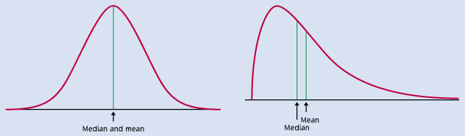
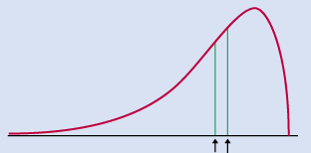
Mean and Median
Mean
Median
Left skew
Mean
Median
Right skew
Mean
Median

Slide 8
Mode, M
The value with the greatest frequency.

Slide 9
Variability of Data
Set 1 | -15 | -10 | -5 | 0 | 5 | 10 | 15
Set 2 | -15 | -5 | -1 | 0 | 1 | 5 | 15
Set 3 | -3 | -2 | -1 | 0 | 1 | 2 | 3

Slide 10
Measures of Variability
Sample range
Sample variance (sample standard deviation)
Interquartile Range (IQR)

Slide 11
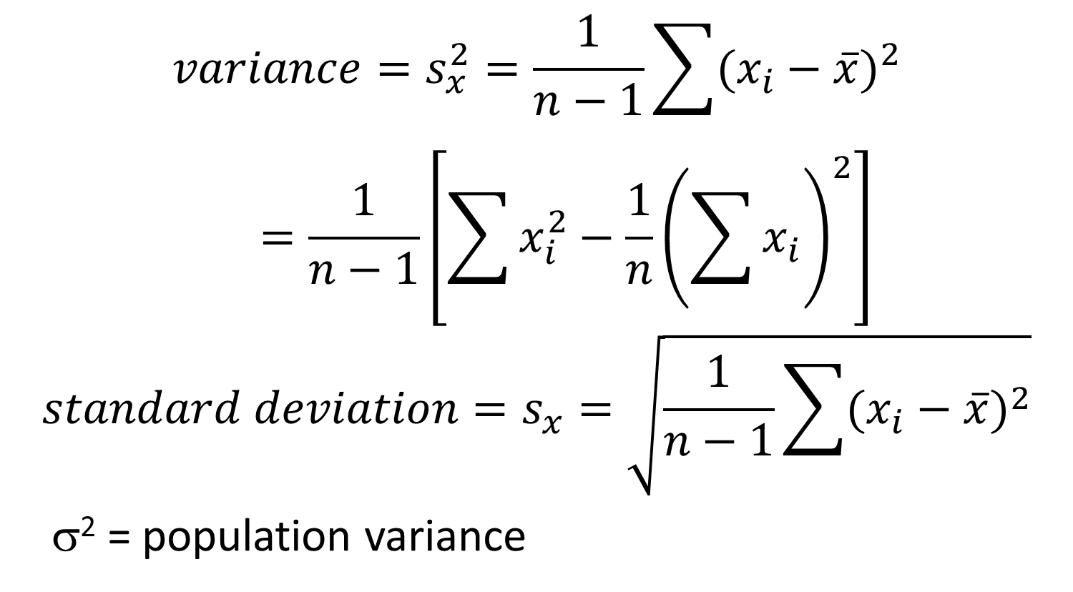
Sample Variance
$$variance=s_{x}^{2}=\frac{1}{n−1}\sum{{(x_{i}−\overline{x})}^{2}}=\frac{1}{n−1}\left[\sum{x_{i}^{2}}−\frac{1}{n}{\left(\sum{x_{i}}\right)}^{2}\right]$$
$$standard deviation=s_{x}=\sqrt{\frac{1}{n−1}\sum{{(x_{i}−\overline{x})}^{2}}}$$
σ² = population variance

Slide 12
Comments for Standard Deviation
Variance is used to determine spread for comparisons.
s² = 0 means that all of the observations are the same, normally s > 0
n = 1
s is not resistant to outliers
s has the same units of measurement as the original observations

Slide 13
Quartiles
Q₁
Q₂
Q₃

Slide 14
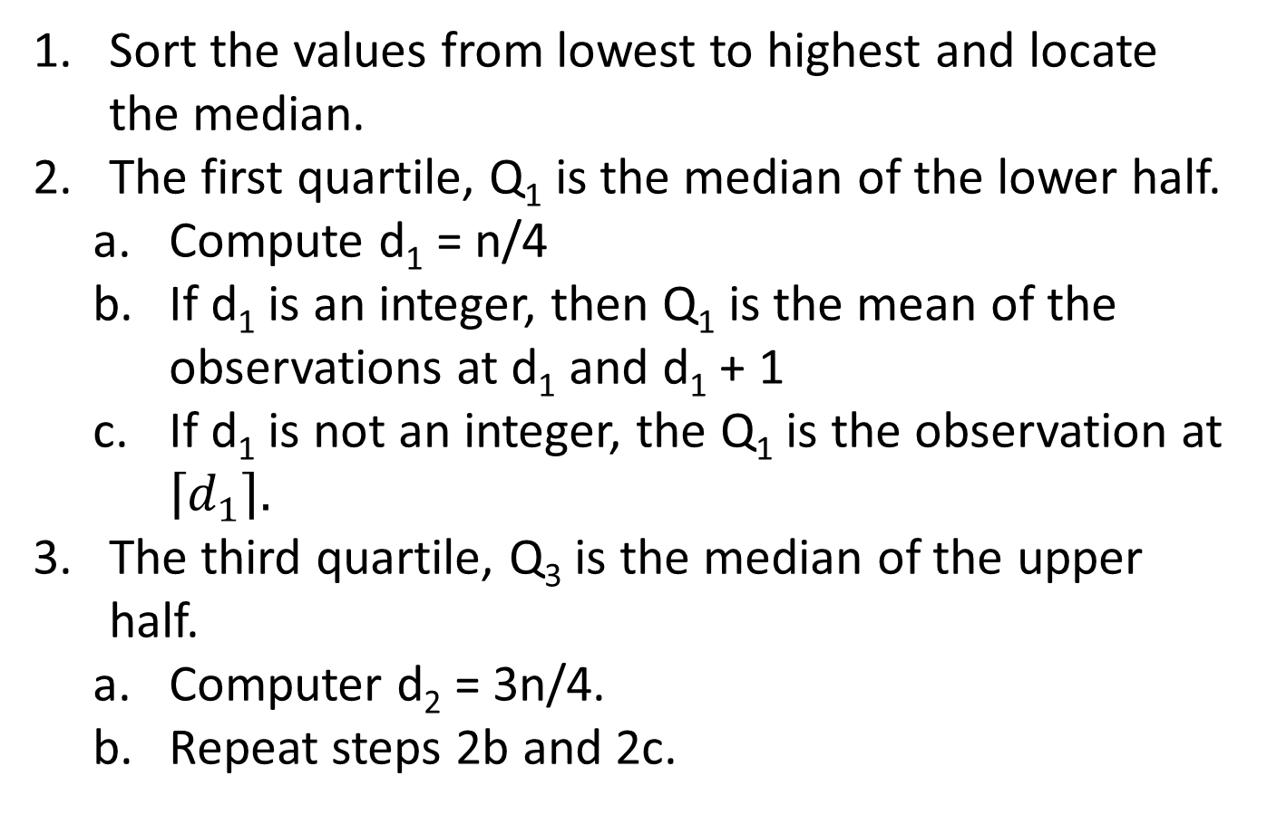
Quartiles - Procedure
Sort the values from lowest to highest and locate the median.
The first quartile, Q₁ is the median of the lower half.
  Compute d₁ = n/4
  If d₁ is an integer, then Q₁ is the mean of the observations at d₁ and d₁ + 1
  If d₁ is not an integer, the Q₁ is the observation at $\left\lceil d_{1}\right\rceil .$
The third quartile, Q₃ is the median of the upper half.
  Computer d₂ = 3n/4.
  Repeat steps 2b and 2c.

Slide 15
Outliers
After finding the IQR, find the two inner fences (low and high) and the two outer fences (low and high)
IF_{L}= Q₁ – 1.5(IQR) IF_{H} = Q₃ + 1.5 (IQR) mild
OF_{L}= Q₁ – 3(IQR) OF_{H} = Q₃ + 3 (IQR) extreme

Slide 16
Boxplots
Procedure
Find Q₁, Q₃, median and IQR
Calculate IF_{L}, IF_{H}, OF_{L}, OF_{H}
Draw a central box from Q₁ to Q₃. Draw a line for the median.
Extend lines (whiskers) from the box to the minimum and maximum values that are not outliers.
Put in closed circles for mild outliers and open circles for extreme outliers.

Slide 17
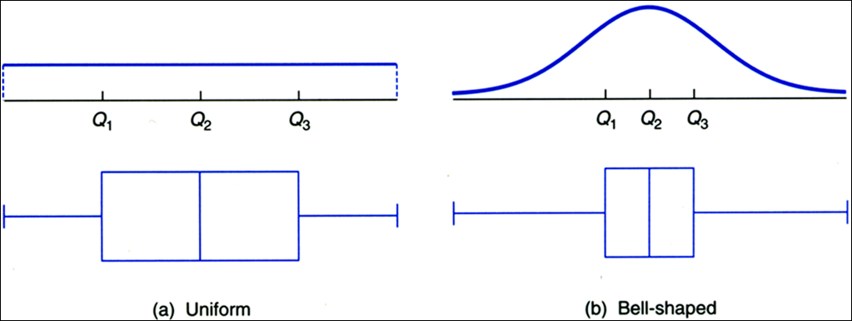
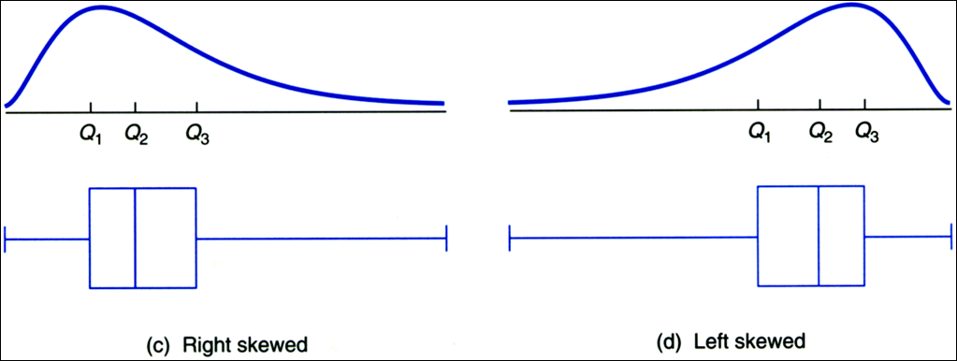
Distributions and Boxplots

Slide 18
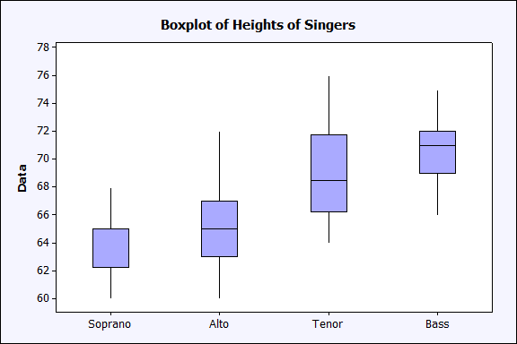
Side-by-side Boxplot: Example

Slide 19
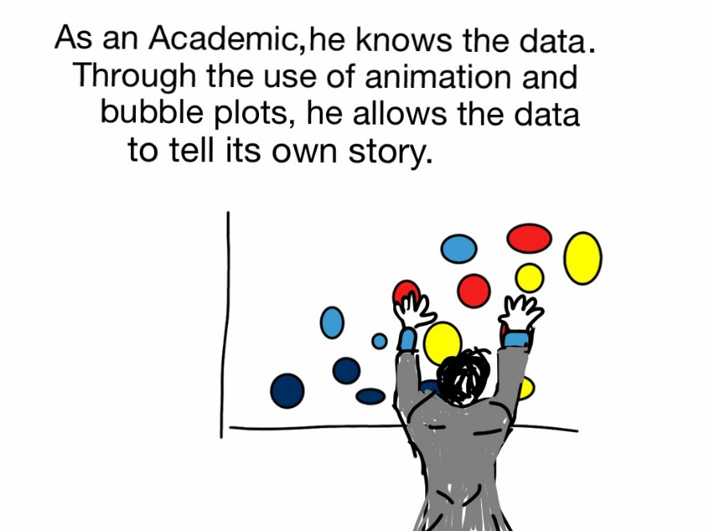
Choosing Measures of Center and Spread
Choices
Mean and standard deviation
Median and IQR
ALWAYS PLOT YOUR DATA!
http://freshspectrum.com/wp-content/uploads/2012/09/
Hans-Rosling-Bubble-Plot-Cartoon.jpg

Slide 20
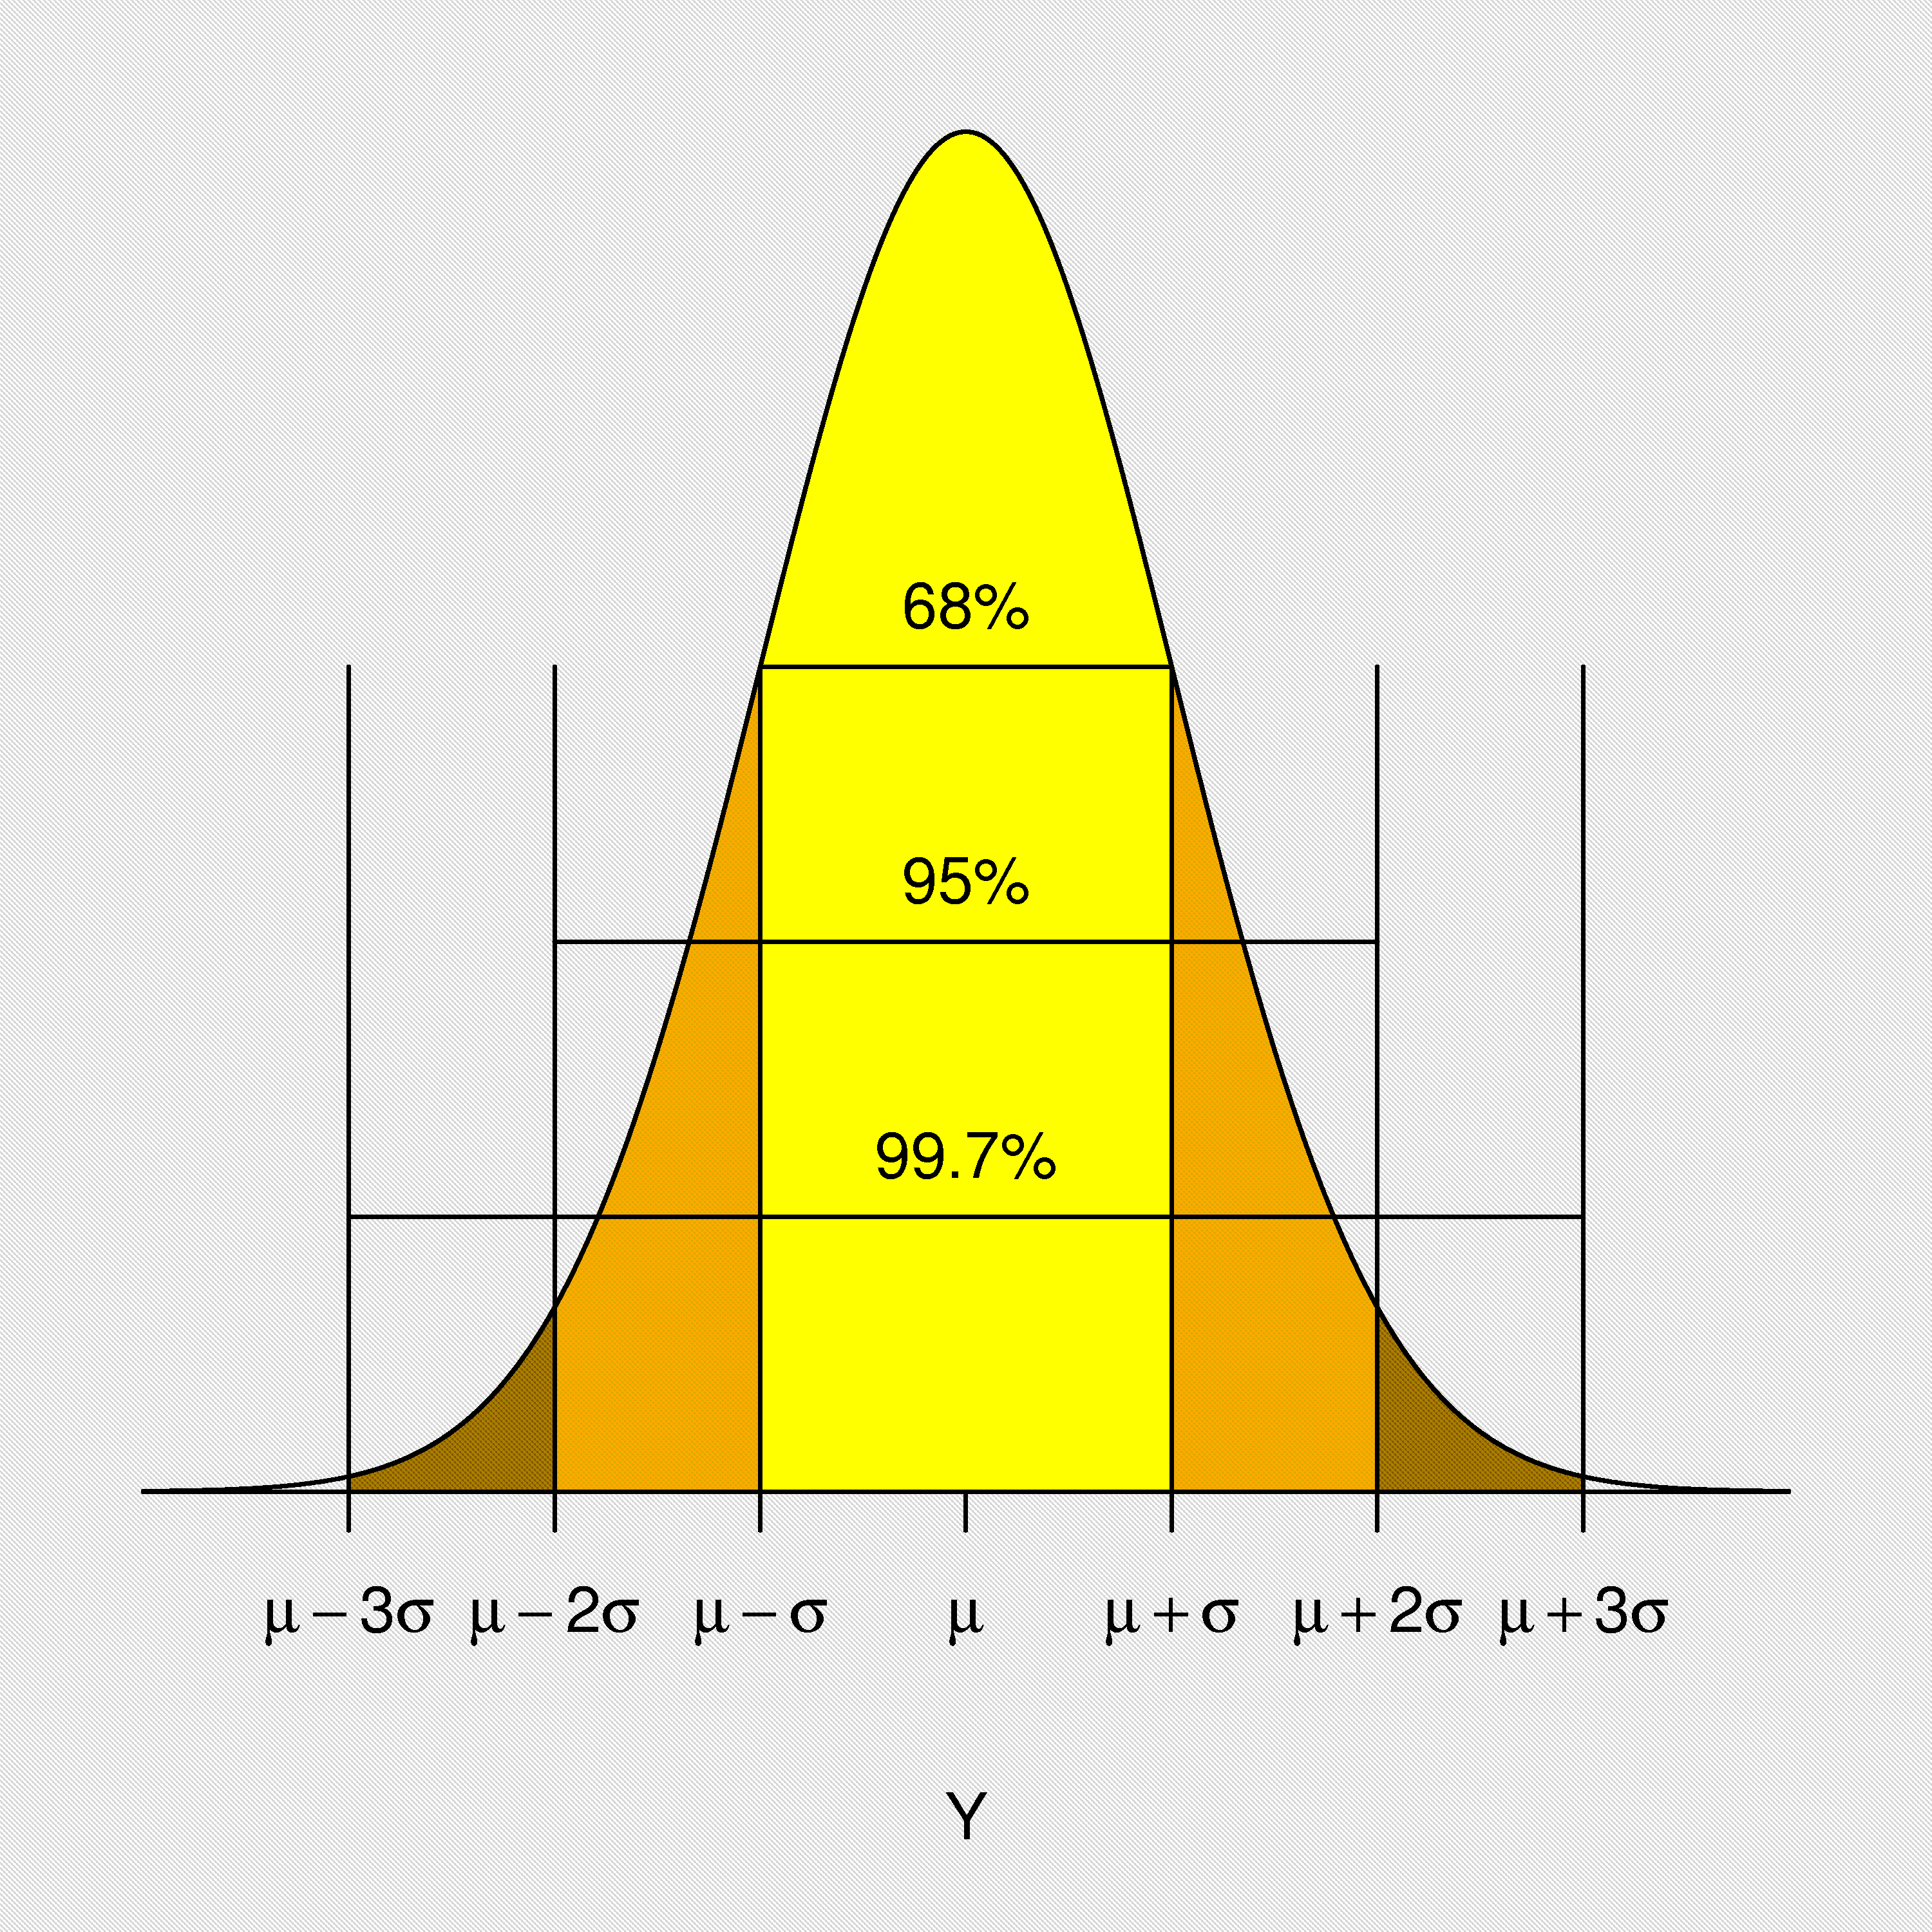
Empirical Rule
68-95-99.7 Rule

Slide 21
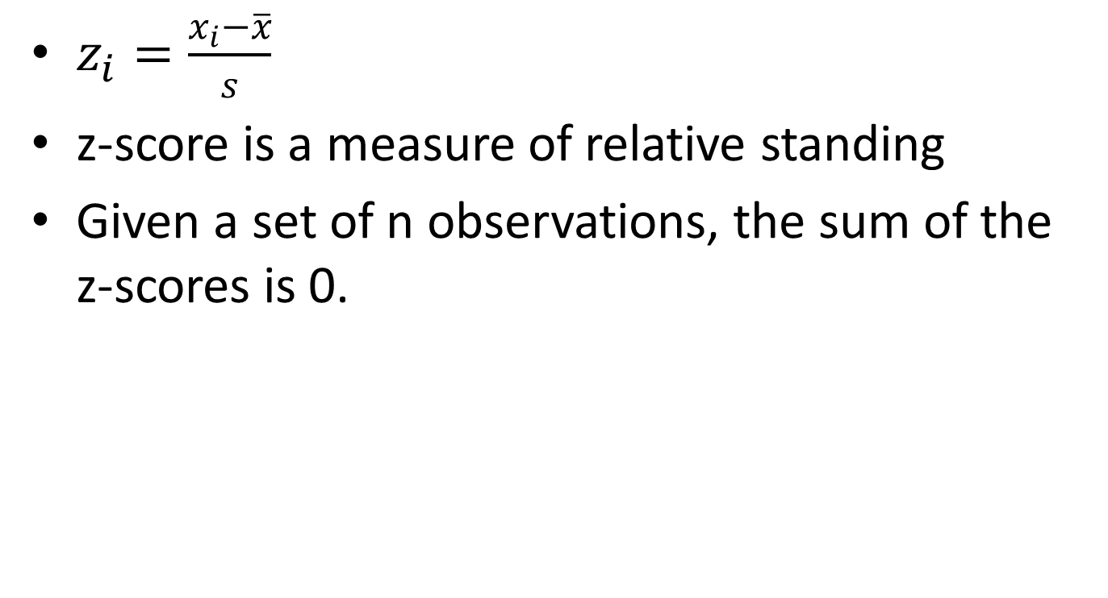
z-score
$z_{i}=\frac{x_{i}−\overline{x}}{s}$
z-score is a measure of relative standing
Given a set of n observations, the sum of the z-scores is 0.

